Slide 1
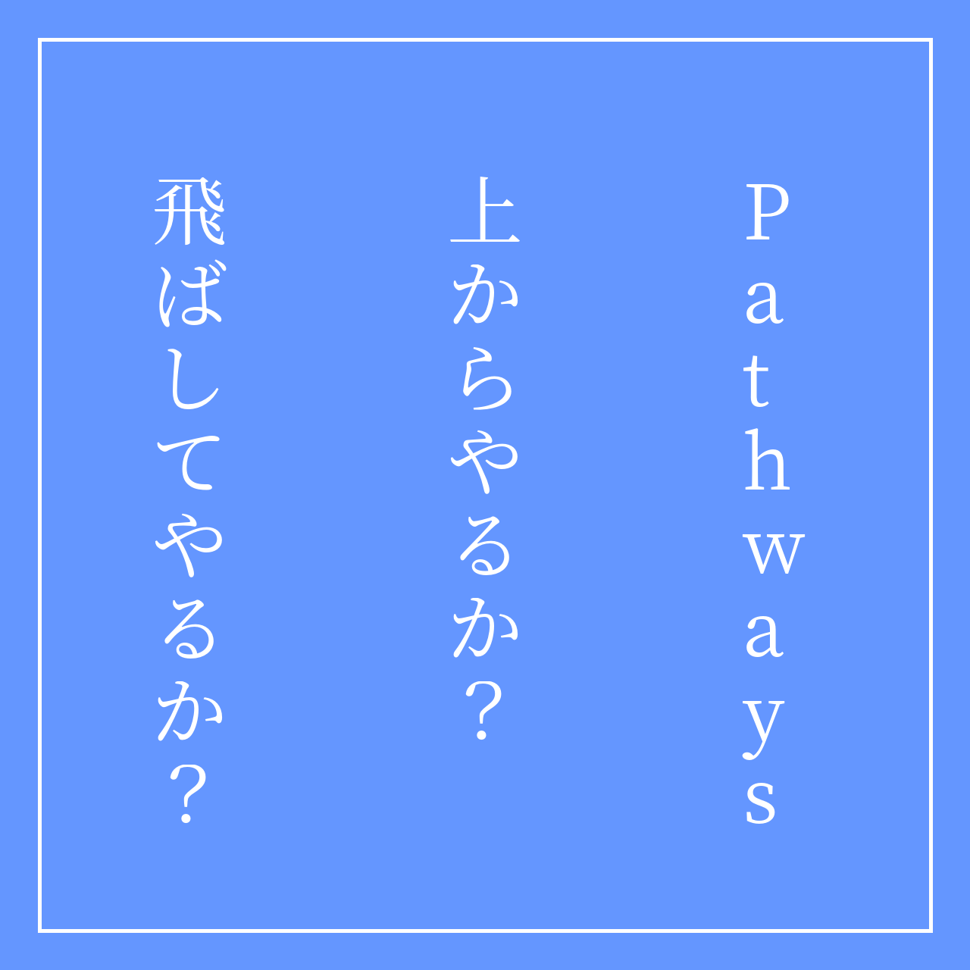

Slide 2
Pathwaysって

Slide 3
Before Pathways
Competent Communication (CC)
スピーチの基礎
Competent Leadership (CL)
リーダーシップの基礎
Advanced Communication Series (15種類)
場面や目的に応じたスピーチ
The Entertaining Speaker
Speaking to Inform
Public Relations など
スキルに基づいたカリキュラム

Slide 4
After Pathways
11のパス
Pathways learning experience
Dynamic Leadership
Effective Coaching
Engaging Humor など
63のプロジェクト
全プロジェクトの説明
パスごとに目的を達成するために必要なプロジェクトが割り当てられている
スピーチプロジェクトとリーダーシッププロジェクトが一体となって組み込まれている
目的に基づいたカリキュラム

Slide 5
どんなPathがあるの？

Slide 6
Path一覧
Dynamic Leadership
This path helps you build your skills as a strategic leader. The projects on this path focus on understanding leadership and communication styles, the effect of conflict on a group and the skills needed to defuse and direct conflict. These projects also emphasize the development of strategies to facilitate change in an organization or group, interpersonal communication and public speaking. This path culminates in a project focused on applying your leadership skills.
Effective Coaching
This path helps you build your skills as a positive communicator and leader. The projects on this path focus on understanding and building consensus, contributing to the development of others by coaching and establishing strong public speaking skills. Each project emphasizes the importance of effective interpersonal communication. This path culminates in a “High Performance Leadership” project of your design.
Engaging Humor
This path is designed to help you build your skills as a humorous and engaging public speaker. The projects on this path focus on understanding your sense of humor and how that sense of humor translates to engaging audience members. The projects contribute to developing an understanding of how to effectively use humor in a speech, including challenging situations and impromptu speeches. This path culminates in an extended humorous speech that will allow you to apply what you learned.

Slide 7
Path一覧
Innovative Planning
This path helps you build your skills as a public speaker and leader. The projects on this path focus on developing a strong connection with audience members when you present, speech writing and speech delivery. The projects contribute to building an understanding of the steps to manage a project, as well as creating innovative solutions. This path culminates in a “High Performance Leadership” project of your design.
Leadership Development
This path helps you build your skills as an effective communicator and leader. The projects on this path focus on learning how to manage time, as well as how to develop and implement a plan. Public speaking and leading a team are emphasized in all projects. This path culminates in the planning and execution of an event that will allow you to apply everything you learned.
Motivational Strategies
This path helps you build your skills as a powerful and effective communicator. The projects focus on learning strategies for building connections with the people around you, understanding motivation and successfully leading small groups to accomplish tasks. This path culminates in a comprehensive team-building project that brings all of your skills together—including public speaking.

Slide 8
Path一覧
Persuasive Influence
This path helps you build your skills as an innovative communicator and leader. The projects on this path focus on how to negotiate a positive outcome together with building strong interpersonal communication and public speaking skills. Each project emphasizes developing leadership skills to use in complex situations, as well as creating innovative solutions to challenges. This path culminates in a “High Performance Leadership” project of your design.
Presentation Mastery
This path helps you build your skills as an accomplished public speaker. The projects on this path focus on learning how an audience responds to you and improving your connection with audience members. The projects contribute to developing an understanding of effective public speaking technique, including speech writing and speech delivery. This path culminates in an extended speech that will allow you to apply what you learned.
Strategic Relationships
This path helps you build your skills as a leader in communication. The projects on this path focus on understanding diversity, building personal and/or professional connections with a variety of people and developing a public relations strategy. Communicating well interpersonally and as a public speaker is emphasized in each project. The path culminates in a project to apply your skills as a leader in a volunteer organization.

Slide 9
Path一覧
Team Collaboration
This path helps you build your skills as a collaborative leader. The projects on this path focus on active listening, motivating others and collaborating with a team. Each project contributes to building interpersonal communication and public speaking skills. This path culminates in a project focused on applying your leadership skills.
Visionary Communication
This path helps you build your skills as a strategic communicator and leader. The projects on this path focus on developing your skills for sharing information with a group, planning communications and creating innovative solutions. Speech writing and speech delivery are emphasized in each project. This path culminates in the development and launch of a long-term personal or professional vision.

Slide 10
ぶっちゃけめんどくさい

Slide 11

アンケートに答えて、ぴったりのパスを選んでもらおう

Slide 12
まずは国際本部にログイン
Toastmasters International のサイトにログイン
初めての場合、パスワードを忘れた場合はForgot Password? をクリックします
Email アドレスを入力し、"Submit"をクリックします
パスワード再設定用のメールが送られてきますので、指示にしたがってください

Slide 13
アンケートはこちら
CHOOSE A PATH: SELECT YOUR PREFERENCES
Select Language
Select Digital Resources
Select Take Assessment
Click Continue

Slide 14

DEMO

Slide 15
どうやってProjectを
始めるの？

Slide 16
Pathをスタート！
上部のメニューの Pathways -> Go to Basecamp をクリックします
"Access my path through Base Camp"の"Go to Base Camp"を選択します
Base Camp画面が開きます
“Paths and Learning"をクリックします
選択したPathが表示されるので、Activateをクリックします

Slide 17
DEMO

Slide 18
Projectをスタート
"Open Curriculum"をクリックします
取り組むプロジェクトを選択します
Level 1 から順番に取り組むことをお勧めします
自分のレベルより先のプロジェクトにに取り組むこともできます
しかし、下位のレベルを完了しない限り、上位のレベルの完了はできません
例) Level 2 のプロジェクトをすべて完了したとしても、Level 1が完了しない限りLevel 2 の完了は認定されません
取り組むプロジェクトを"Activate"してから"Launch"します

Slide 19
DEMO

Slide 20
Projectをスタート
プロジェクトが表示されますので、順にe-learningで学習を進めてください
あるいは、プロジェクトの内容をPDFで一括ダウンロードすることもできます
"別のセクションへ移動"で”あなたの評価”ページへ移動
"マイプロジェクトを印刷"をクリックするとPDFがダウンロードできます。
プロジェクトの内容を良く確認し、スピーチを作成してください
"あなたの評価"ページの"論評リソース"をクリックし、論評シートをダウンロードし、論評者に送付してください

Slide 21
DEMO

Slide 22
スピーチが終わったら
「スキルの評価（課題終了後）」ページのアセスメントを実施します
最後のページまで移動し「おめでとうございます！」が表示されることを完了します
スピーチが終わるまでは、「おめでとうございます！」ページまで進めないように
これでプロジェクトは完了です。

Slide 23
DEMO

Slide 24
Levelが完了したら
Level X Completion を "Activate"する
Level X Completion を "Mark Complete"する
BaseCamp Manager (President, VPE, Secretary)に通知が届きます
BaseCamp Managerが承認するとLevelの完了が認定されます

Slide 25
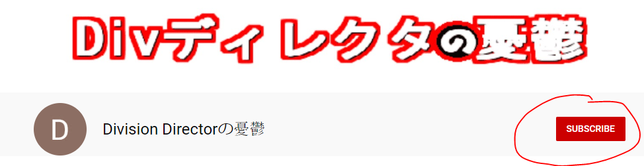

https://www.facebook.com/groups/1740883752614082/
Notes:
最後にYoutuberっぽいことを。
チャンネル登録よろしくね！
Facebookグループへの登録もよろしくお願いします。
Youtubeとともに情報発信していきたいと思います

